Slide 1

Final Project Sentiment Analysis and Topic Modeling on Trip Advisor Hotel Reviews
University of Texas at Dallas
BUAN6342 - NLP
Dr. Elkhodari, Gasan
Group #1
Akoju Srivalli - sxa220078
Dodda Durga Siva Ram Naidu - dxd220016
Mohammed, Afsaruddin - axm210415
Sudeeksha Golla - sxg210150

Slide 2
Use Case
Hotel reviews are gold mine of customer insights for any hotel business. Also, its importance increases by many folds since majority of the future customers rely on the peer reviews while finalizing their stay. Travel planning and hotel booking on website has become one of an important commercial use.
We consider the problem of classifying a hotel review as a positive or negative and thereby analyzing the sentiment of a customer.
We address the challenge of classifying TripAdvisor hotel reviews into specific topics to provide users with detailed insights into the areas they are interested in exploring.

Slide 3
Methodology
Corpus
Data Preparation and Cleansing:
Python Code Interpretation:
Testing Model:

Slide 4

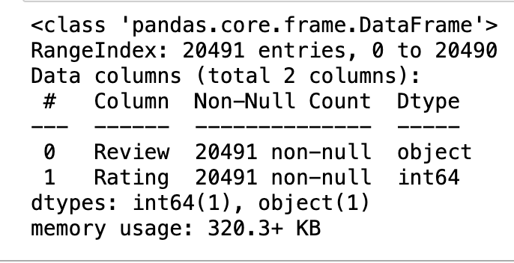
Corpus
The dataset contains 3 columns, with 20.491 rows for each column.
There are three columns in the data set:
Serial : Unique identifier for each review
Review : Text of the review
Rating : Rating of the review on a five-star scale

Slide 5
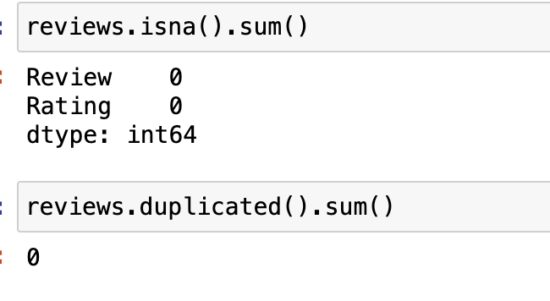
Data Cleaning
Raw hotel reviews contain tons of irrelevant or just meaningless data that can badly affect model accuracy. This makes it hard for machines to process and affects the results of your analysis. so, we need to clean them up.
Check any null and duplicated values.
No null and duplicated values in our dataset.

Slide 6
Data Preprocessing
Remove ‘empty’ review and words with only 1 letter
Lower all text
Tokenize and split text to words
Remove numbers and stop words ( ‘a’, ‘an’, ‘the’, ‘of’, ‘in’, etc.), to help improve accuracy to give more focus to the important information
Part-of-Speech (POS) tagging: Categorizing words in a text (corpus) in correspondence with a particular part of speech, depending on the definition of the word
Lemmatize the text: transform every word into their root form (caring to care)

Slide 7
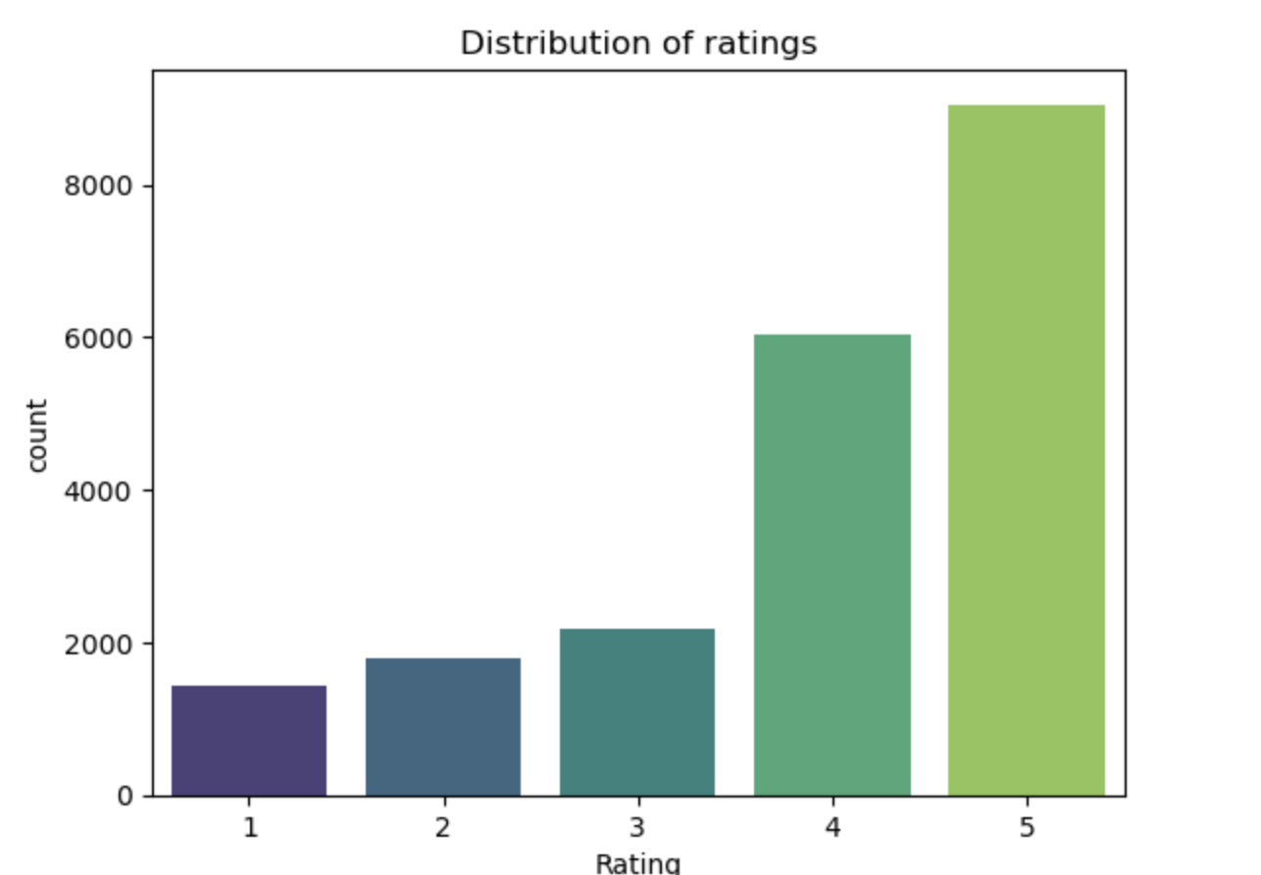
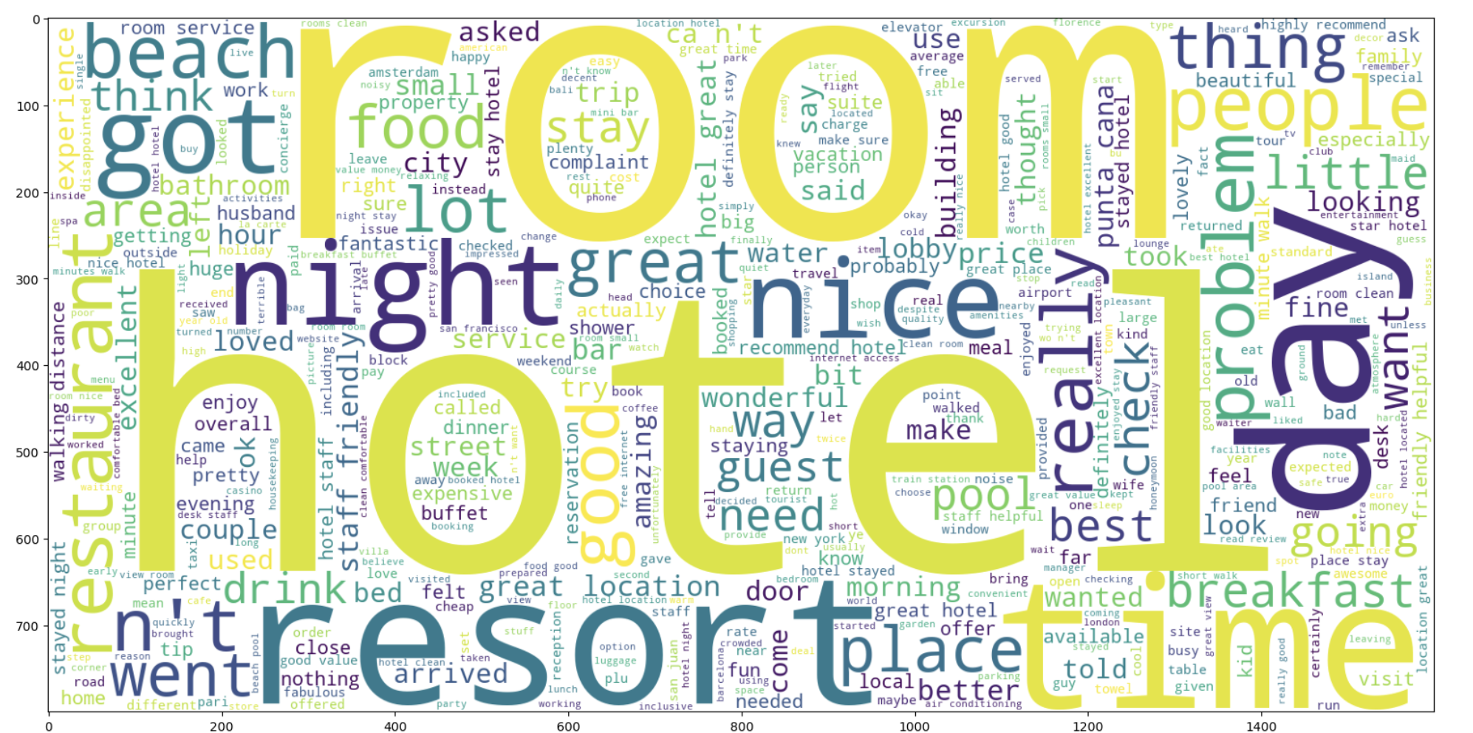
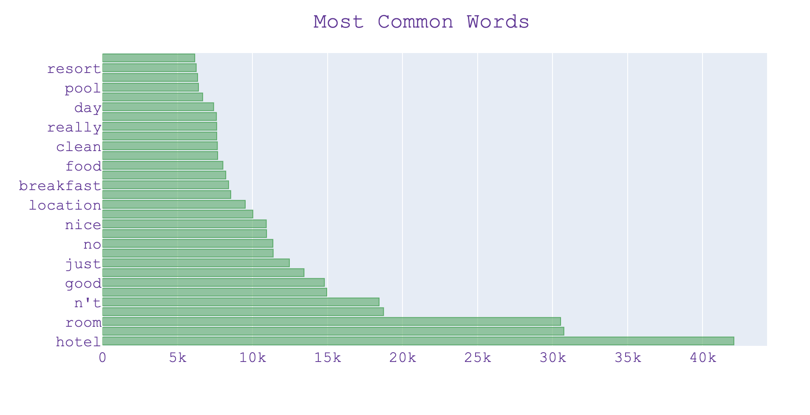
Exploratory Data Analysis

Slide 8
Sentiment Analysis
Load the dataset using pandas.
Clean the reviews by applying techniques such as lowercasing, removing punctuation, and handling stopwords.
Use NLTK's Sentiment Intensity Analyzer
Apply sentiment analysis to the 'cleaned_review' column.
Create a new column 'comp_score' based on the 'compound' score.
Check accuracy using scikit-learn's accuracy_score.
Utilize classification_report and confusion_matrix for detailed insights.

Slide 9
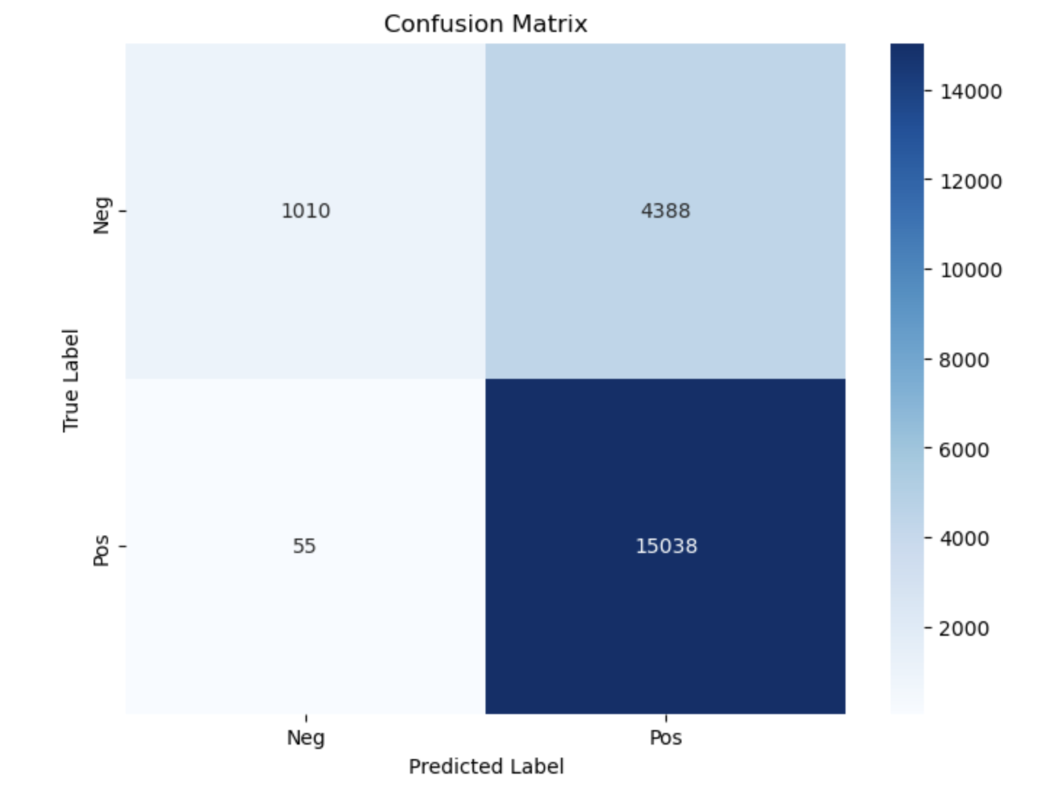
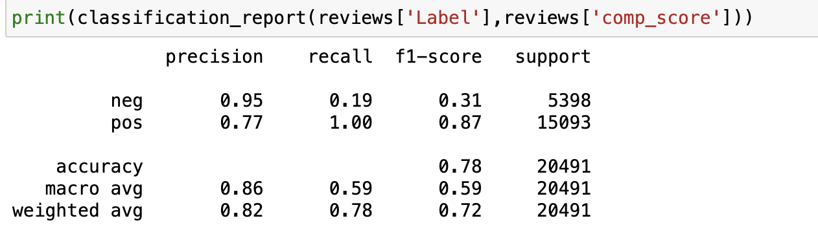
Classification Report and Confusion Matrix

Slide 10
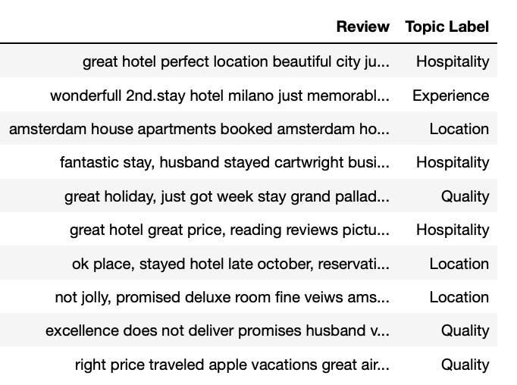
Topic Modelling
Create a CountVectorizer object to convert text data into a Document-Term Matrix (DTM).
Transform the review text data into a dtm and fit the LDA model to the dtm.
Access the topics generated by LDA and retrieve the top words for each topic.
Apply the LDA model to the dtm to get topic probabilities for each review. Then, identify the topic with the highest probability for each review.
Create a dictionary that maps topic numbers to topic labels.

Slide 11
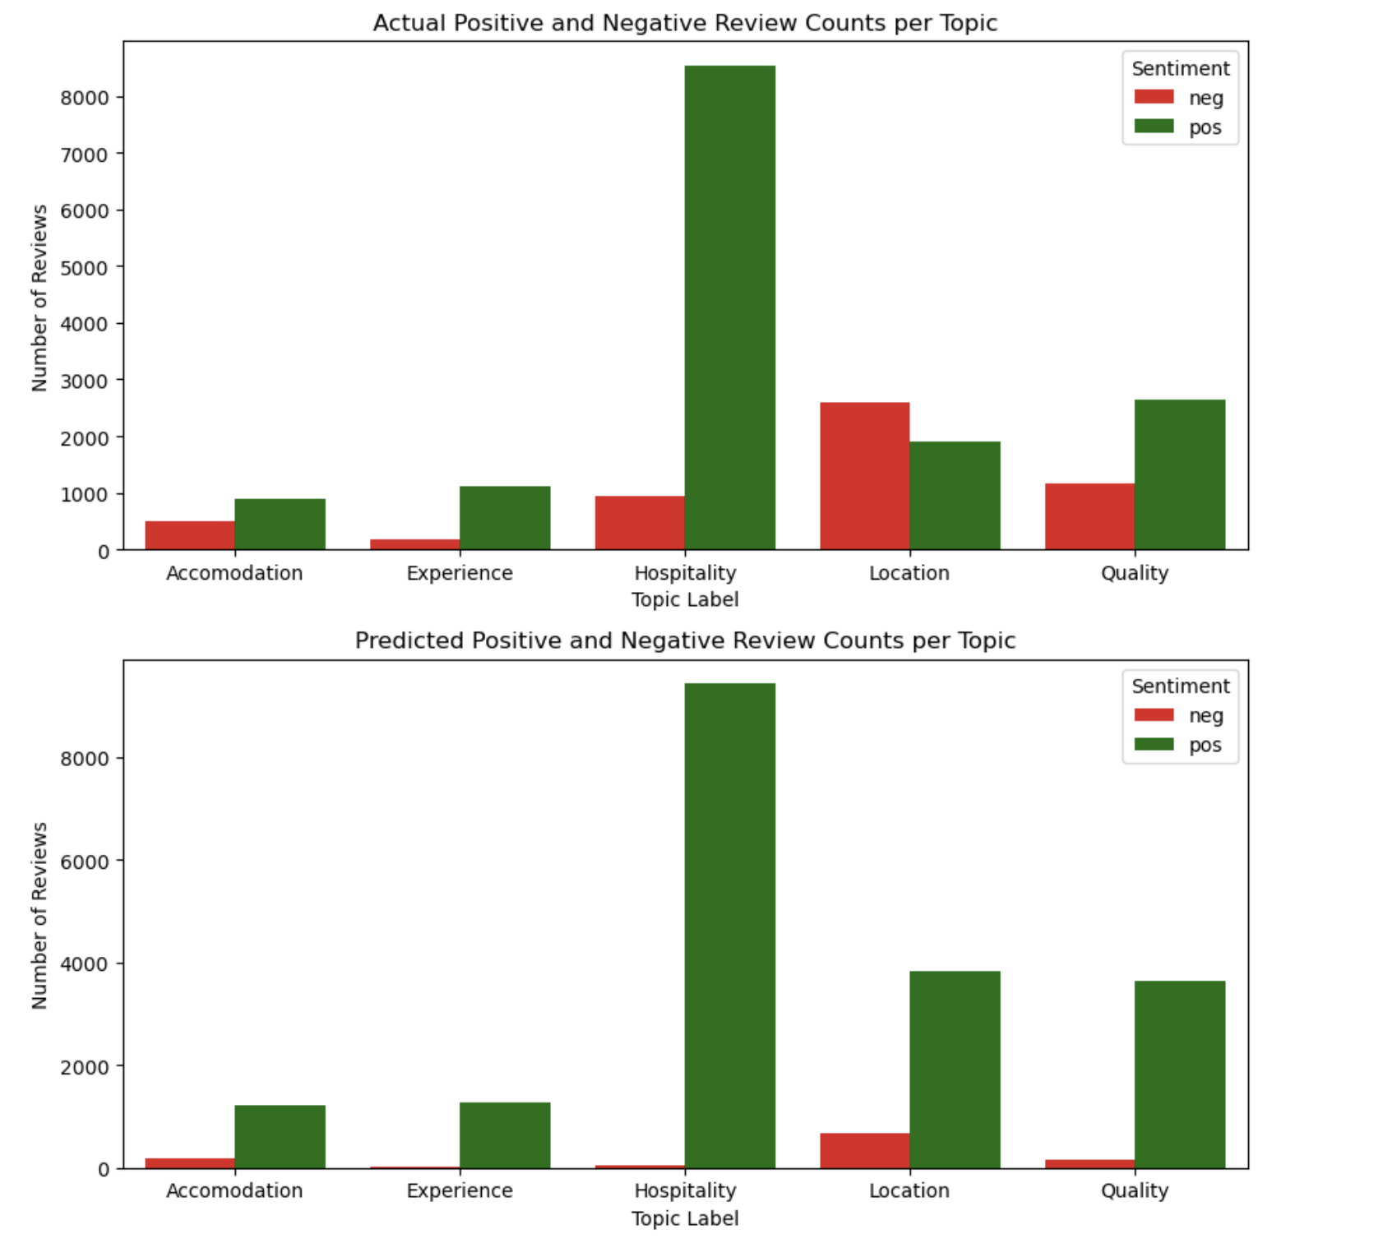
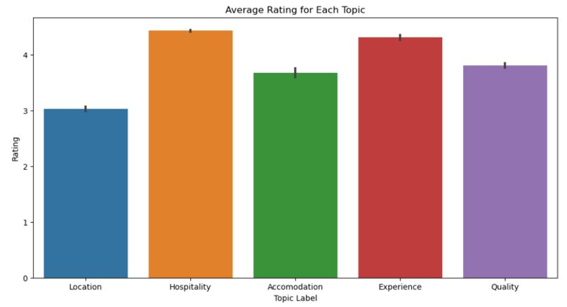
Conclusion and Summary
The sentiment analysis revealed that reviews related to hospitality received the highest number of positive responses.
The study presented the average ratings associated with each identified topic, offering a clearer understanding of customer satisfaction in different areas.
The data showed a nearly equal distribution of positive and negative reviews for the 'Location' topic, indicating mixed customer opinions in this area.

Slide 12
References
Data Source: https://www.kaggle.com/datasets/andrewmvd/trip-advisor-hotel-reviews/data

